Slide 1
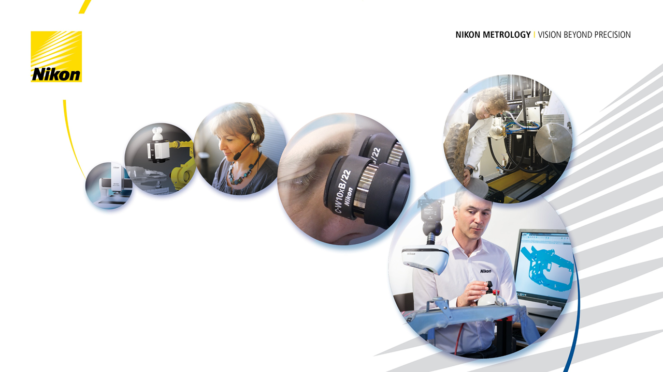
Introduction to X-ray Imaging James Finch

Slide 2
Structure
What are X-rays?
Generating X-rays
Casting a shadow
Detecting X-rays
Computed Tomography (CT)

Slide 3
What are X-rays?

Slide 4
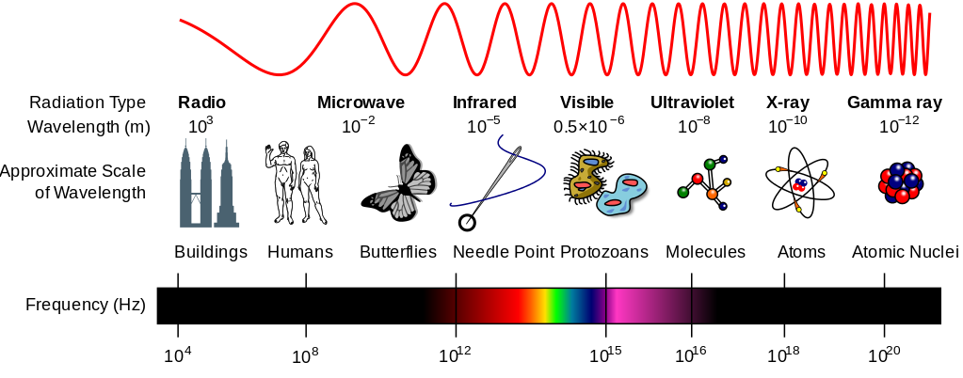
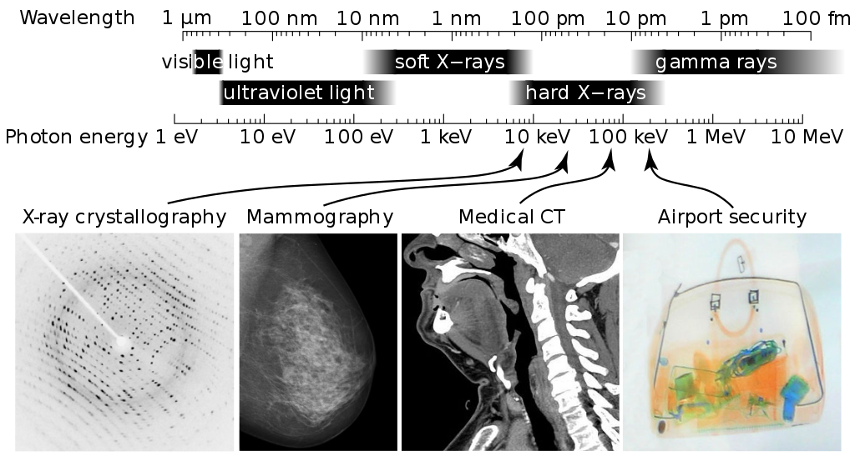
What are X-rays?
X-rays are electromagnetic radiation, like visible light and radio waves
They travel in straight lines
Once the source is switched off, they dissipate immediately
The energy of individual X-rays is measured in eV (electron-volts)
Nikon X-ray sources produce X-ray energies in the hundreds of thousands of eV: 30-450 keV
Image courtesy of Wikimedia Foundation

Slide 5
Generating X-rays: X-ray Sources

Slide 6
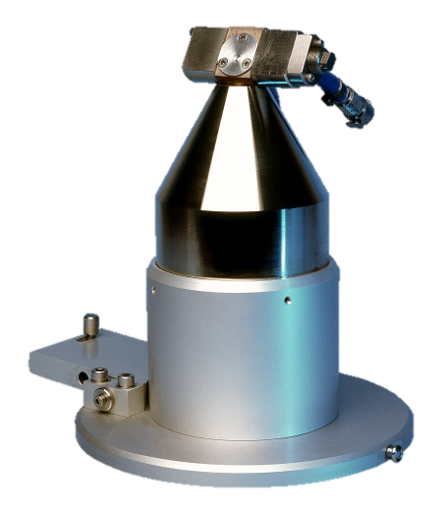
Generating X-rays: Reflection Target
A hot filament emits electrons
High voltage between the filament and anode attracts and accelerates the electrons into a beam
X/Y coils steer the beam into the magnetic lens, which focuses the beam down to a few µm
The electrons impact the target, producing X-rays
Over 99% of the electron beam’s power is transformed into heat.
The target is liquid cooled.
The X-ray source is continuously pumped to a high vacuum. The output window seals the vacuum whilst allowing X-rays out
Filament
Anode
X/Y Coils
Magnetic Lens
Output window
X-rays
Target

Slide 7
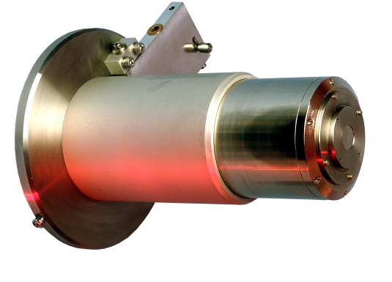
Generating X-rays: Transmission Target
The transmission target consists of a thin layer of tungsten on the inside surface of the output window; the target is the output window.
This allows:
A smaller focal spot size than reflection targets
Higher magnifications, as the focal spot is 0.25 mm behind the output window
Anode
Magnetic Lens
Target Window
Filament
X-rays
X/Y Coils

Slide 8
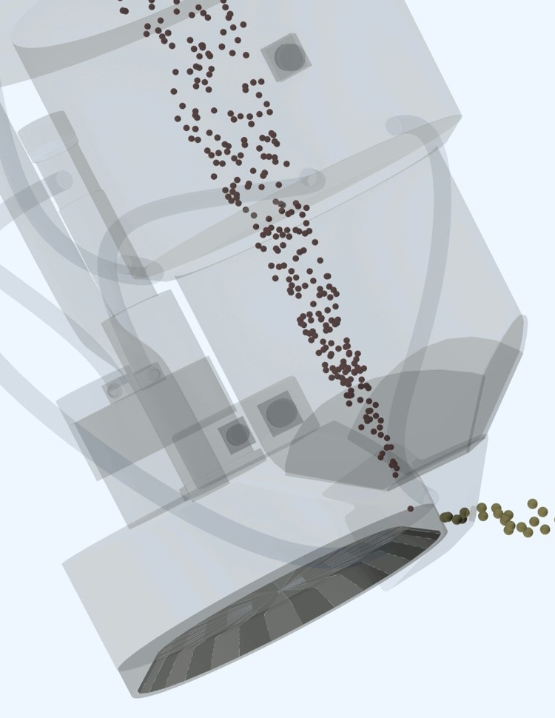
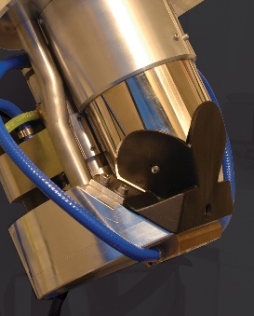
Generating X-rays: Rotating Reflection Target
The rotating reflection target focuses the electron beam onto the edge of a spinning disc.
This allows for much better heat dissipation.
Compared to the static reflection target, the rotating reflection target allows:
Twice the maximum power (450W)
Significantly smaller focal spot sizes at higher powers
The rotating target is operator-interchangeable with other targets.

Slide 9
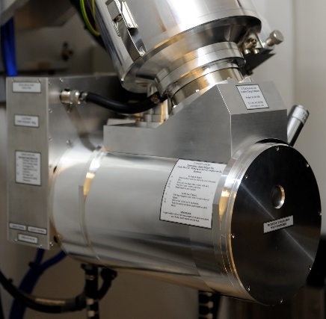
Generating X-rays: 320 Module
The 320 module applies up to +100kV to the target, boosting the maximum beam energy to 320kV
This allows:
Better penetration through dense samples
Higher maximum power of 320W
The 320 module is operator-interchangeable with other targets
Cathode
-220kV
320kV total
Target
+100kV

Slide 10
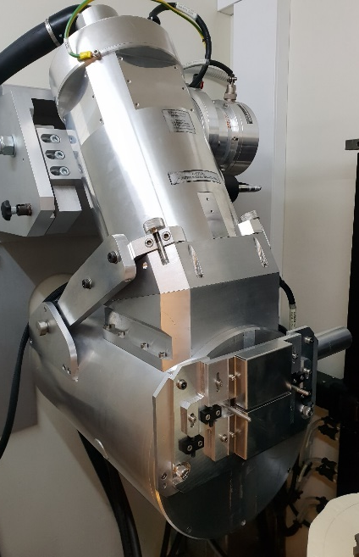
Generating X-rays: 450kV Reflection Target
The 450kV reflection target applies up to +225kV to the target, bosting the maximum beam energy to 450kV.
This allows for better penetration through dense samples.
Cathode
-225kV
450kV total
Target
+225kV

Slide 11
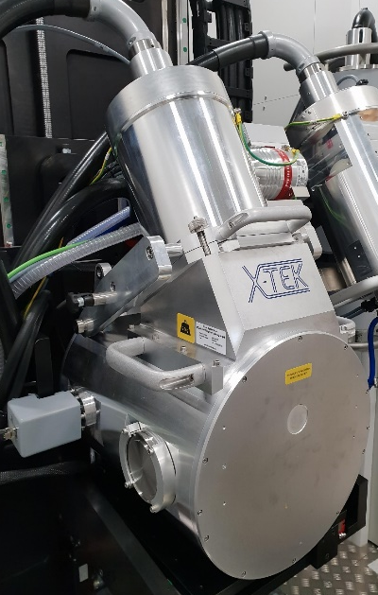
Generating X-rays: 450kV Rotating Target
The 450kV reflection target applies up to +225kV to the target, bosting the maximum beam energy to 450kV.
This allows for better penetration through dense samples.
The rotating target focuses the electron beam onto the edge of a spinning disc.
Compared to the static target, the rotating target allows significantly smaller focal spot sizes at higher powers.
Cathode
-225kV
450kV total
Target
+225kV

Slide 12
Generating X-rays: Production Mechanisms

Slide 13
Generating X-Rays: Bremsstrahlung Radiation
e-
A high speed electron is deflected by the atoms in the target and loses energy
This energy is released as an X-ray
As electrons may be deflected by different amounts, Bremsstrahlung releases a continuous spectrum of X-ray energies up to the electron beam energy
Target + Atom
X-ray emission
e-

Slide 14
Generating X-rays: Characteristic Emission
A high speed electron collides with an electron in the target atom and knocks it out of its orbital. This leaves a hole behind
e-
Target
Nucleus
e-
e-
e-

Slide 15
Generating X-rays: Characteristic Emission
A high speed electron collides with an electron in the target atom and knocks it out of its orbital. This leaves a hole behind
An electron in a higher-energy shell “falls down” to fill the lower-energy shell. This transition releases energy as an X-ray
As there are only specific energy levels that the orbital electrons can be in, there are only specific transitions possible – these are characteristic of the target material
e-
Target
Nucleus
e-
e-
e-
X-ray emission

Slide 16
Generating X-rays: The X-ray Spectrum
Bremsstrahlung and Characteristic Emission both occur when electrons hit the target
Characteristic emission lines
Continuous Bremsstrahlung emission
Relative intensity
Lowest energy X-rays don’t make it out of the source
X-ray energy / keV
Accelerating voltage
controls maximum X-ray energy

Slide 17
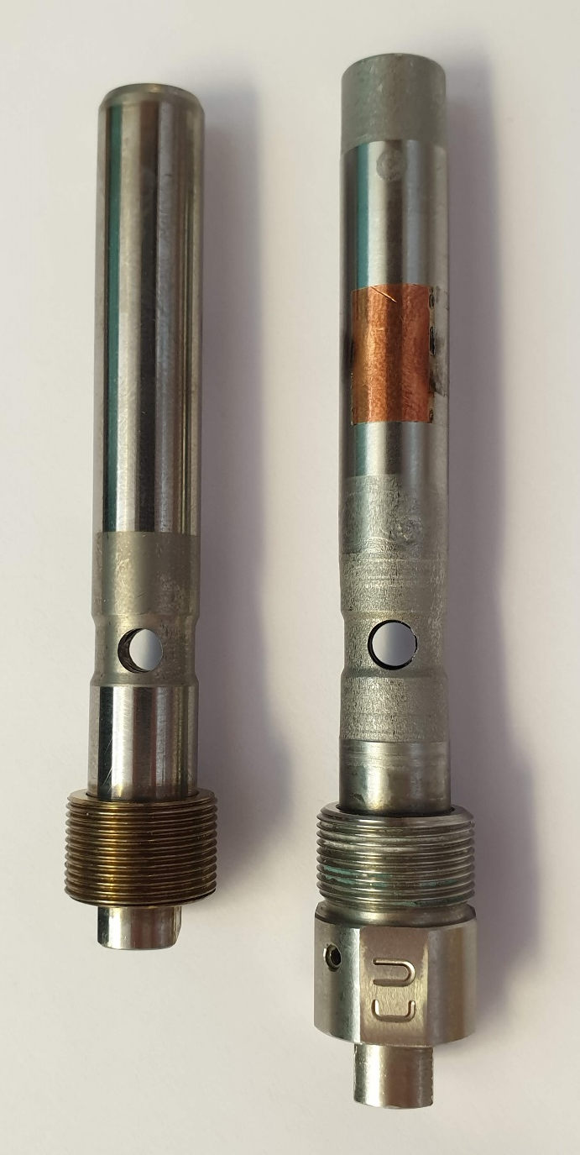
Multi-metal reflection target
The standard reflection target is made from Tungsten (W) because it has intense characteristic emission around ~60keV.
At accelerating voltages below that, the characteristic emission no longer occurs.
The multi-metal reflection target offers a choice of 4 metals. The characteristic emission peaks of these are:
Tungsten (W): 58-69 keV
Silver (Ag): 22-26 keV
Molybdenum (Mo): 18-20 keV
Copper (Cu): 8-9 keV
Mo is the most commonly used alternative to W.
Tungsten reflection target
Multi-metal reflection target

Slide 18
Casting A Shadow

Slide 19
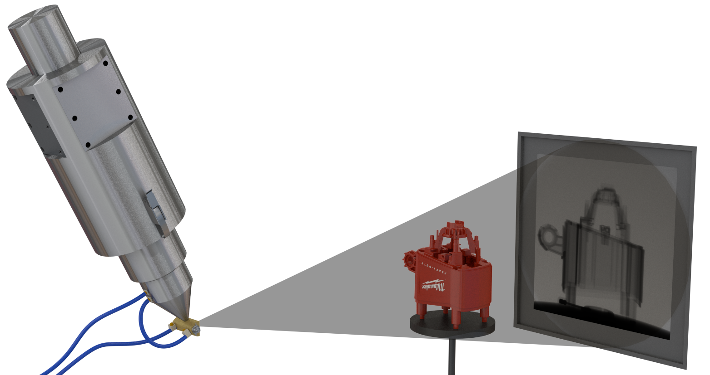
Casting A Shadow
Just like light, X-rays travel in straight lines from the source. Where X-rays are absorbed by the sample, they leave a shadow image.
Unlike light, some X-rays will always penetrate the sample. Denser and thicker parts of the sample absorb more X-rays, so the darkness of the shadow tells us how much material is in the path of the X-rays.

Slide 20
Casting A Shadow: Attenuation
X-rays are absorbed as an exponential decay.
I.e., if one millimetre of a material absorbs half of the X-rays, then the next millimetre will absorb half of what remains: one quarter of the original beam.
The density of electrons in the sample material affects how quickly X-rays are absorbed; samples with a higher atomic (Z) number or higher density will absorb more X-rays.

Slide 21
Casting A Shadow: Attenuation
Higher energy X-rays penetrate further
By increasing the beam energy, we get higher energy X-rays which are more penetrating.
By reducing the beam energy, we get only lower energy X-rays which are absorbed easier and give better contrast.
We can also adjust the beam current, which gives us more or fewer X-rays of the same energy. This affects brightness but not penetration.
X-ray energy
Penetration

Slide 22
Casting A Shadow: Effect of changing kV
The energy of each individual X-ray is measured in keV (kilo electron-volts).
A 200kV accelerating voltage produces X-rays with energies up to but never more than 200keV. The beam is described as 200kVp (peak).
Most X-ray emission is at lower energies.
Although increasing the accelerating voltage (kV) does produce more high-energy X-rays, it doesn’t affect penetration as much as you might expect.
Relative intensity
200kVp
225kVp
X-ray energy / keV
61keV mean
66keV mean
200
225

Slide 23
Casting A Shadow: Effect of filters
Adding a metal filter in front of the X-ray source will remove low-energy X-rays from the beam, increasing the mean energy and therefore penetration.
Because filters remove X-rays, they also make the beam significantly darker (increasing noise).
Relative intensity
200kVp
no filter
200kVp
2mm Copper
X-ray energy / keV
200
65keV mean
112keV mean

Slide 24
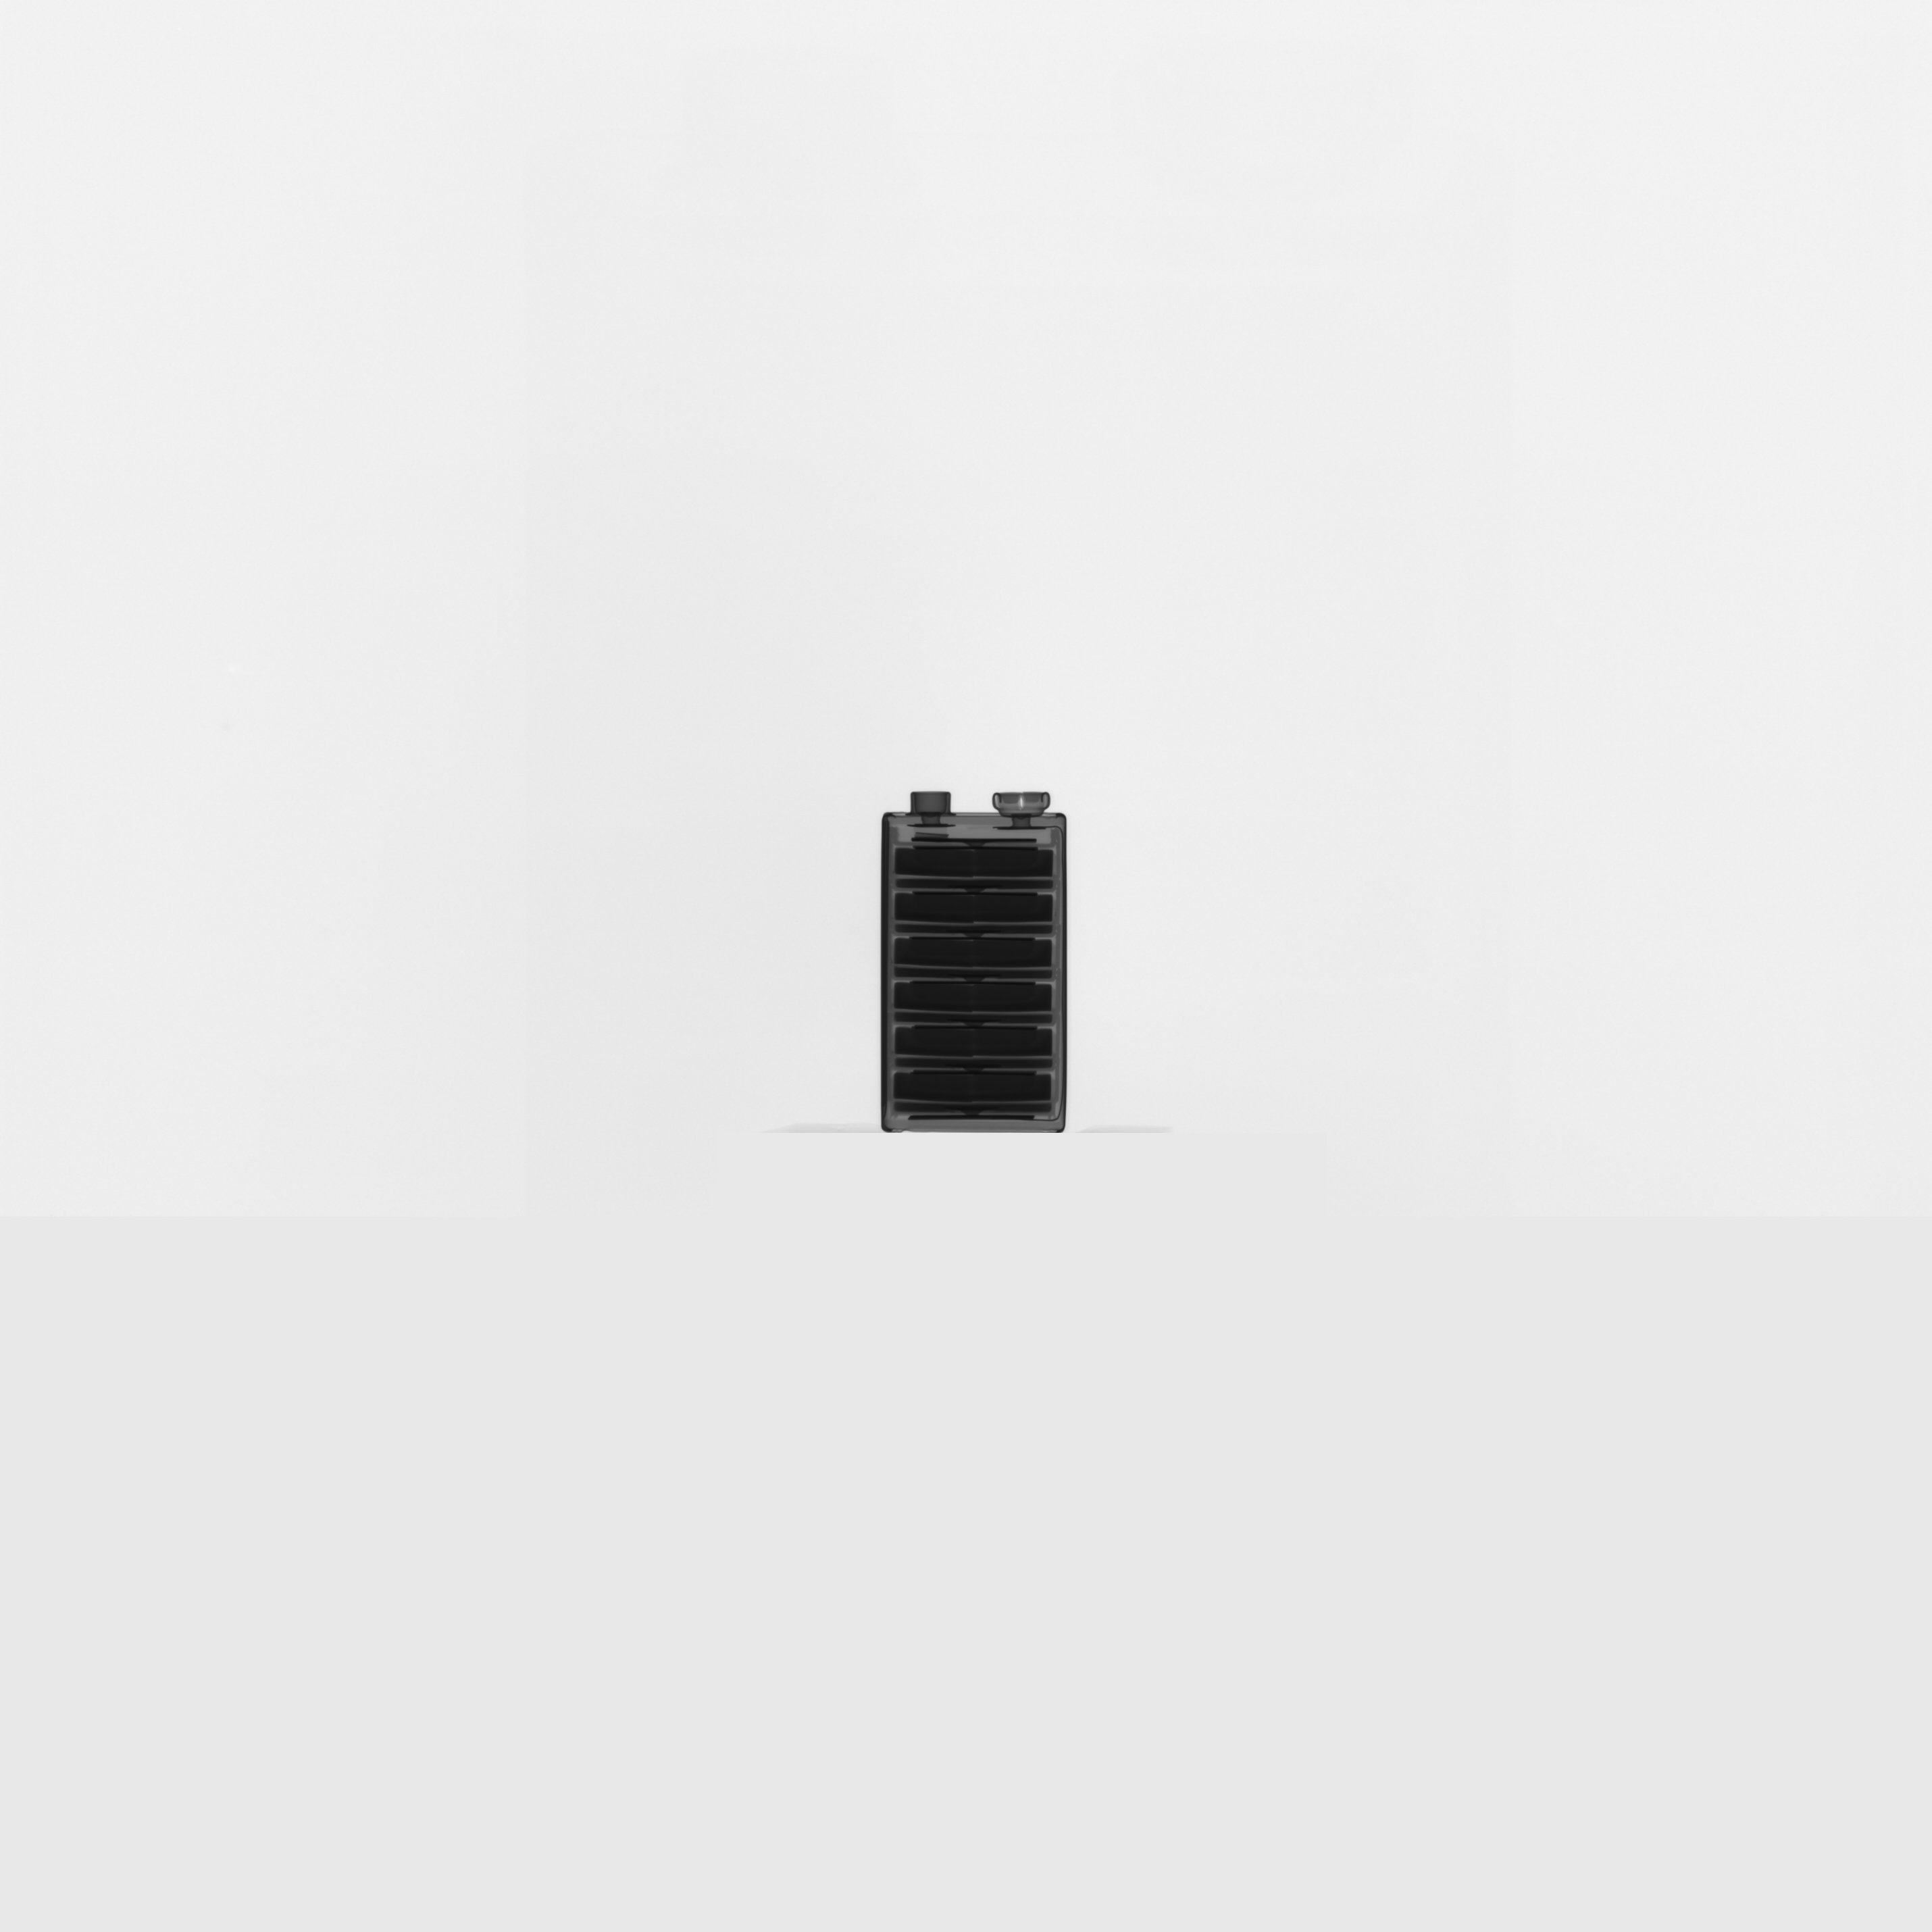
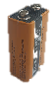

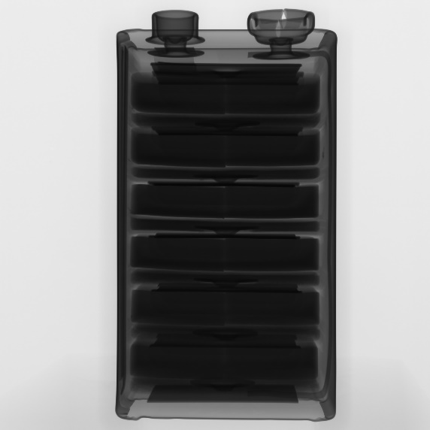
Casting A Shadow: Geometric Magnification
The X-ray beam starts as a point, and spreads out as a cone to the detector.
X-rays are extremely hard to bend, so we don’t use a lens like with visible light. Instead, we move the sample within the cone beam to take advantage of geometric magnification.
A sample placed close to the detector will not be magnified much
A sample placed close to the X-ray source will be highly magnified
You can test this with the light on your phone and your hand!
Low magnification: Sample far from source
High magnification: Sample close to source

Slide 25
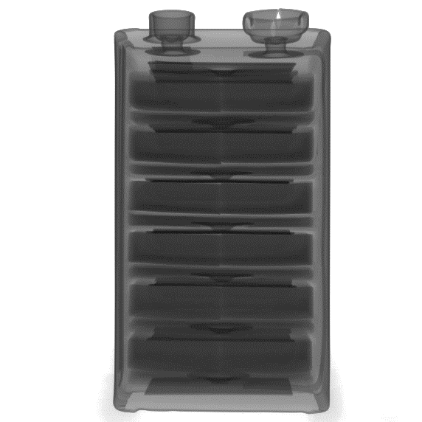
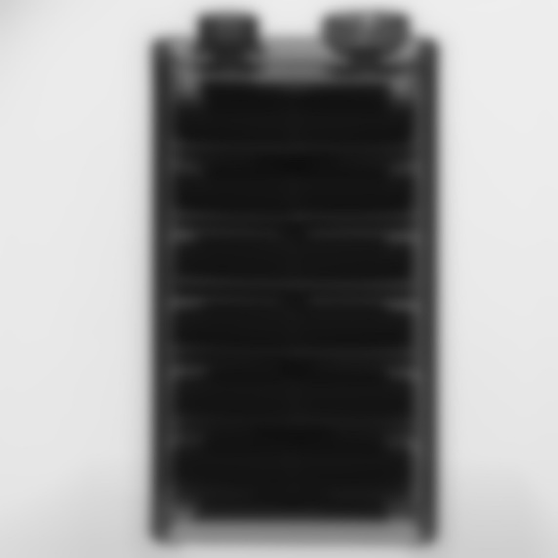
Casting A Shadow: Geometric Unsharpness
At high geometric magnifications, any blurring (unsharpness) caused by the focal spot is magnified.
It is essential to have a small focal spot size to avoid blurring at high magnifications.
Microfocus X-ray sources have a focal spot in the micron-range, providing sharp images at extremely high geometric magnifications.
Small focal spot
Large focal spot
blurring

Slide 26
Detecting X-rays

Slide 27
Detecting X-rays
Most modern X-ray systems use a Digital Flat Panel Detector
These consist of two layers:
X-rays are absorbed by the scintillator crystal and re-emitted as visible light
The visible light is detected by photodiodes
A digital flat panel is effectively a very large digital camera sensor, with a scintillator in front.

Slide 28
Detecting X-rays: Effective Pixel Size
If the sample is halfway between the source and detector, the image will be twice as large as the sample; there is 2x geometric magnification.
This means that a 100µm pixel represents 50µm in the sample. The effective pixel size is 50µm.
To reduce blurring caused by the X-ray source, we should try to keep the X-ray focal spot size less than the effective pixel size.
2x geometric magnification
50µm
100µm

Slide 29
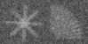
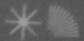
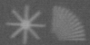
Detecting X-rays: Noise
1 second
All images contain some amount of noise. This is also true of X-ray images.
To improve the Signal-to-Noise Ratio, you can use a brighter X-ray source or a longer exposure time; either of these will increase the X-ray flux – the number of X-rays reaching the detector.
The SNR improves with the square root of flux, so an image that takes 16x as long to acquire will be 4x less noisy. The more noise you remove, the harder it gets to remove more noise.
16 seconds
128 seconds

Slide 30
Computed Tomography

Slide 31
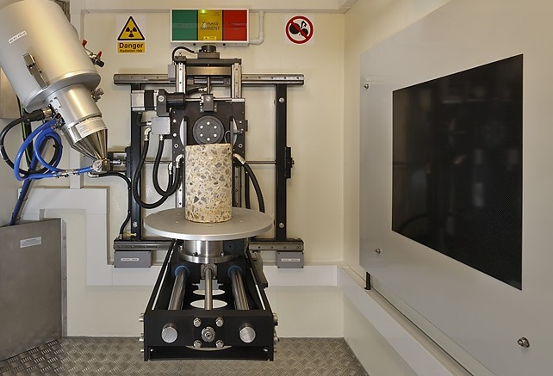
What is CT?
Computed Tomography (CT) provides a 3D map of the X-ray absorption throughout the sample.
By rotating the sample 360 degrees whilst acquiring images, we get projection images from every angle.
These projection images are then reconstructed into a 3D volume.

Slide 32
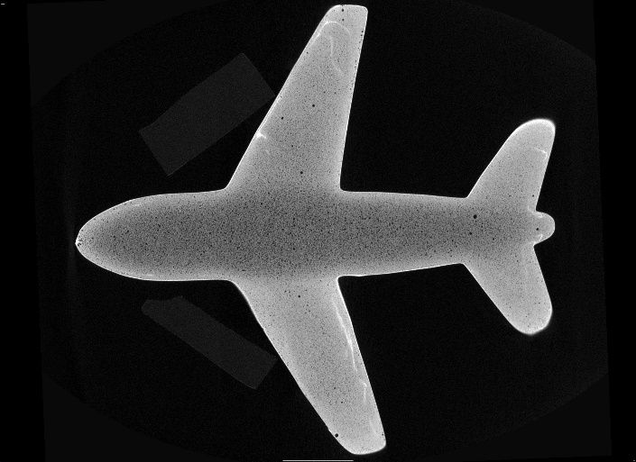
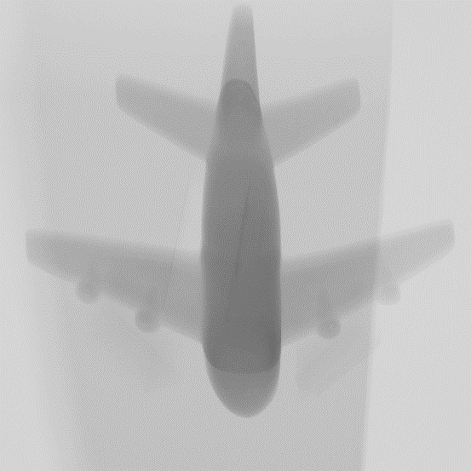
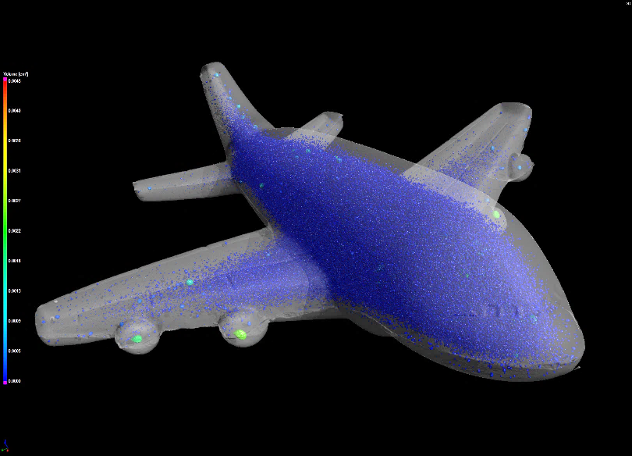

CT: Acquisition, Reconstruction and Analysis
Acquisition
Projection Images
Reconstruction
2D Slices + 3D Rendering
Analysis
Results

Slide 33
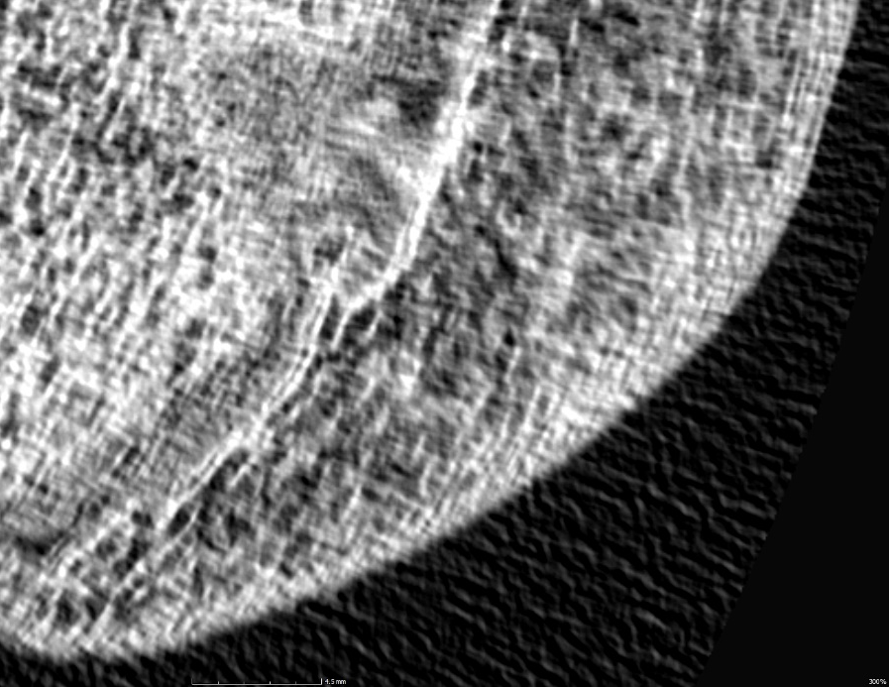
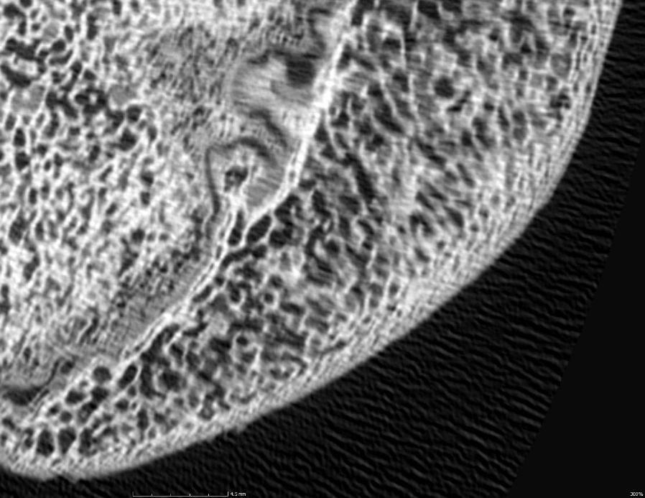
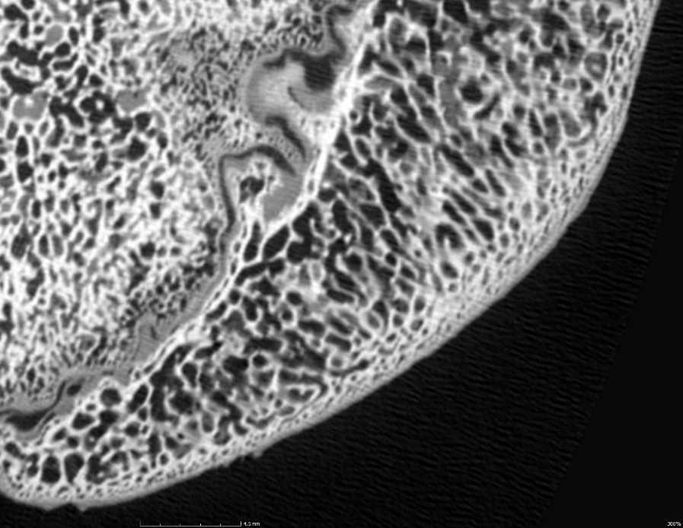
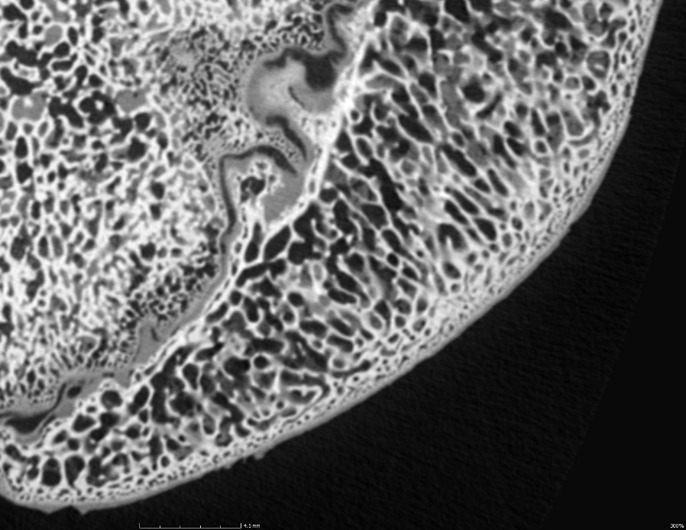
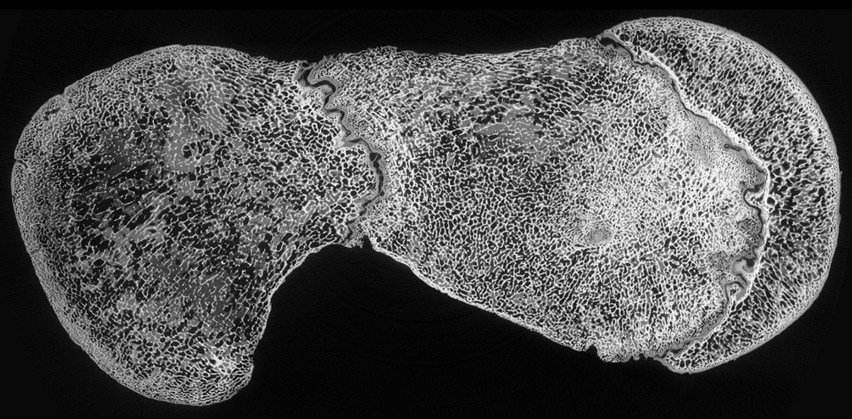
CT: Number of projection images
During the scan, no part of the sample should move more than one pixel across the detector between projection images.
If it does, fine detail will be lost to fringes. This affects the edges of the scan the most.
The optimum number of projections depends on the number of pixels horizontally on the detector that the sample rotates across.
Acquiring more projections than necessary will not improve feature recognition further, however the extra data will reduce noise.
500 projections
1000 projections
2000 projections
3000 projections

Slide 34
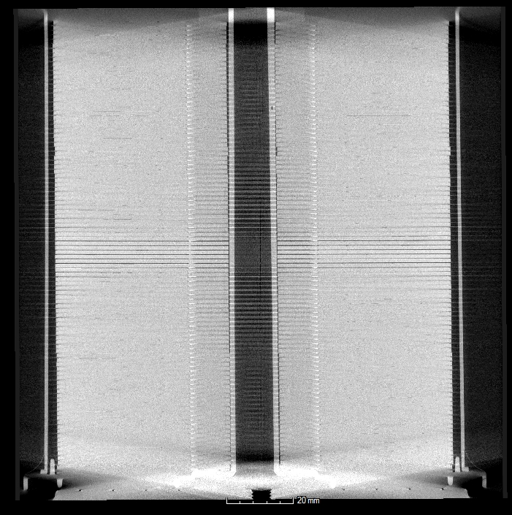
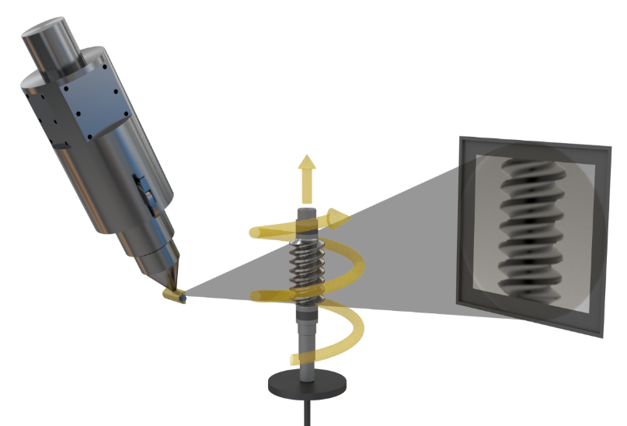
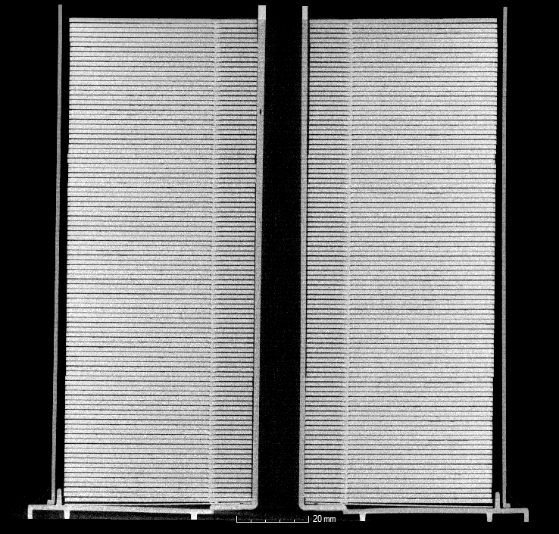
X.Tend Helical Acquisition
With X.Tend, the stage rotates and Y axis moves up at the same time. This is ideal for long parts with a small diameter.
Reduces artefacts
Provides higher resolution
Allows taller samples
Circular CT
X.Tend

Slide 35
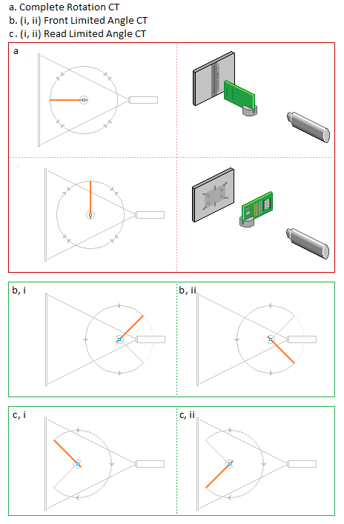
Limited Angle CT
Limited Angle CT allows more flexibility to scan regions of large samples by avoiding collision with the source or detector
Higher magnification for better resolution at edges of large samples
Lower magnification for larger field-of-view at edges of large sample

Slide 36
Beam Hardening

Slide 37
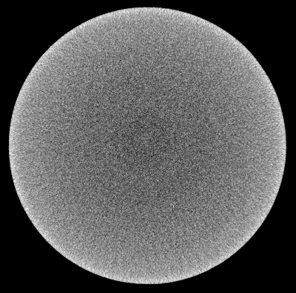
Beam Hardening
High-energy (hard) X-rays are more likely to penetrate deeper through the sample than low-energy (soft) X-rays.
As the X-rays travel through the sample, the lower energy X-rays are removed from the beam leaving behind only higher energy X-rays – the beam gets harder.
This means that we get much more X-ray absorption at the edges of the sample. This is called beam hardening.

Slide 38
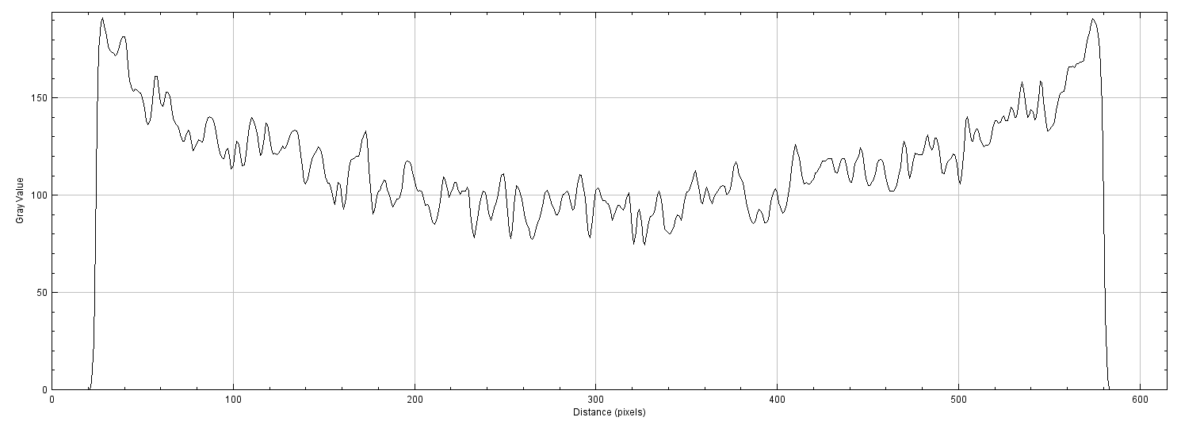
Beam Hardening
The bright-to-dark gradient is a common symptom of beam hardening.
This can be seen as “cupping” in a line profile.

Slide 39

Beam Hardening
Disk of 40mm diameter (orange) and considering a chord of 4.5mm (blue)

Slide 40
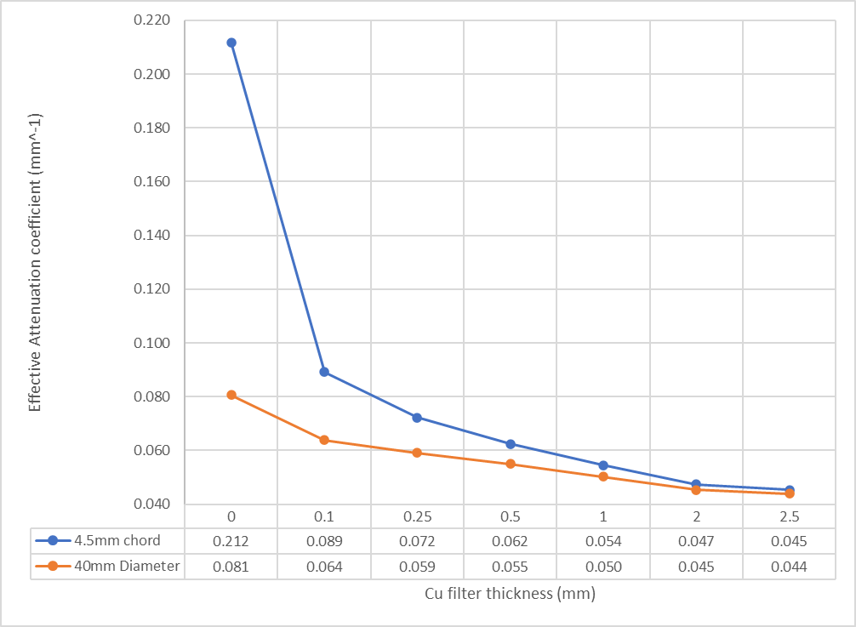
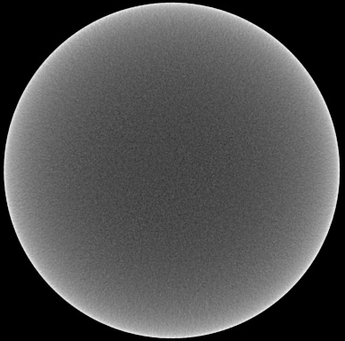
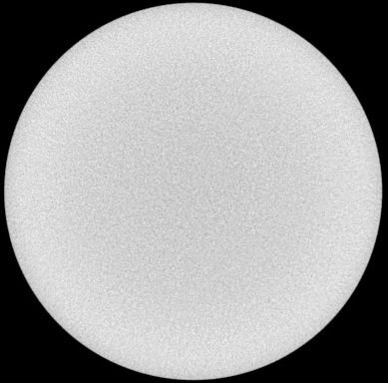
Beam Hardening
Left to right: 0, 1, 2.5mm Cu

Slide 41
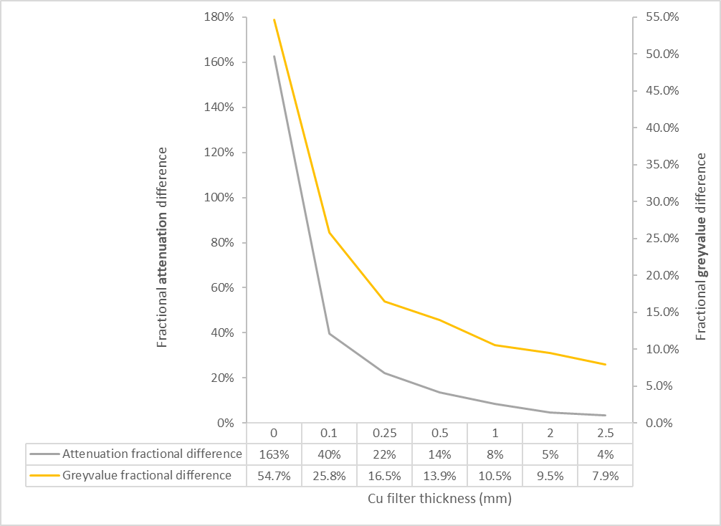
Beam Hardening – hardware correction
Left to right: 0, 1, 2.5mm Cu

Slide 42
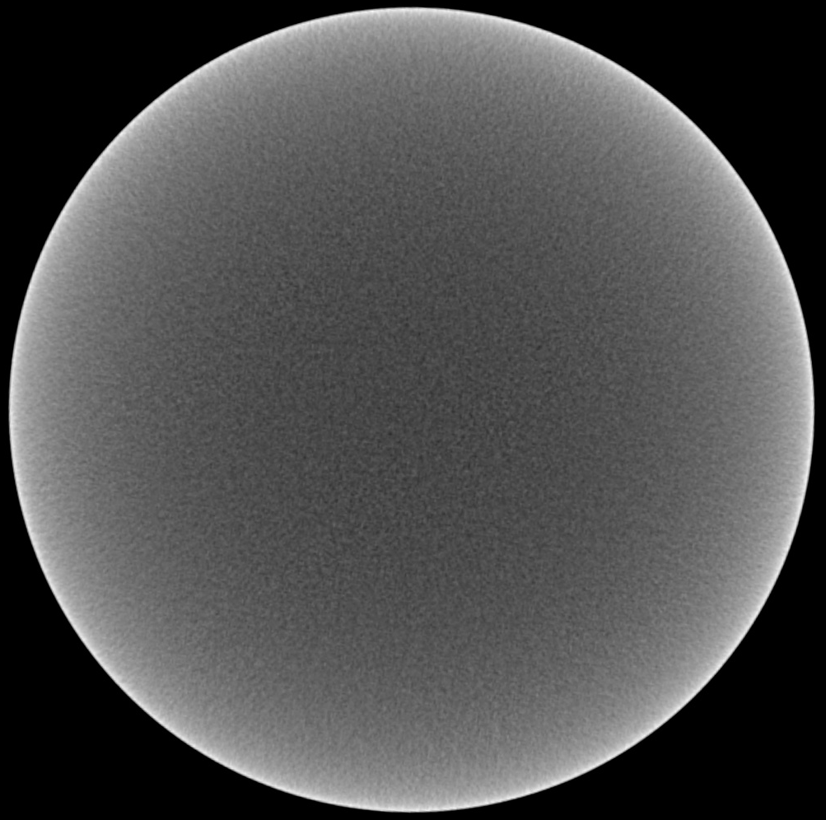
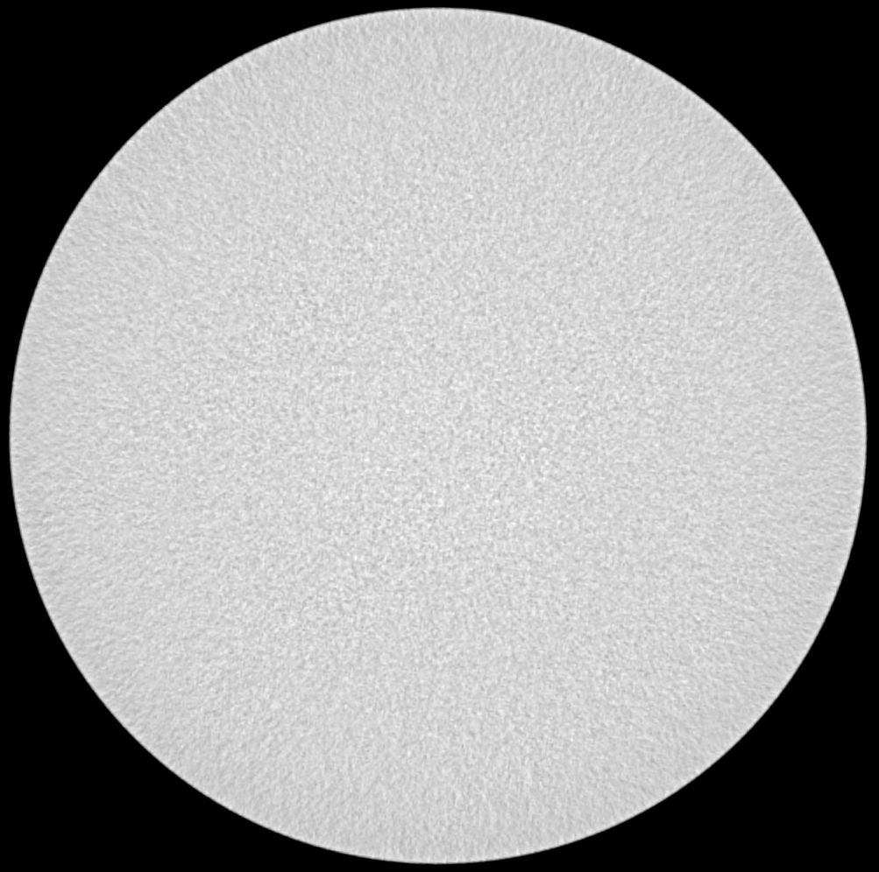
Beam Hardening – software correction
Left to right: 0mm Cu, 0mm Cu with beam hardening correction
Greyvalue difference: 54.7% uncorrected, 7.9% corrected

Slide 43


